Slide 1
Toomer ES
BUDGET FEEDBACK MEETING
To be presented to GO Team BEFORE the school staffing conference

Slide 2
NORMS
This is a meeting of the GO Team. Only members of the team may participate in the discussion. Any members of the public present are here to quietly observe.
We will follow the agenda as noticed to the public and stay on task.
We invite and welcome contributions of every member and listen to each other.
We will respect all ideas and assume good intentions.

Slide 3
GO TEAM BUDGET DEVELOPMENT PROCESS
YOUR SCHOOL STRATEGIC PLAN…
is your roadmap and your role.
It is your direction, your priorities, your vision, your present, your future.
Step 1: Data Review
Step 2: Strategic Plan Review
Step 3: Budget Parameters
(Strategic Priorities)
Step 4: Budget Choices
Notes:
Today I will provide an overview of the budget allocations for FY23. We will begin the work of funding the strategic priorities we agreed upon during our strategic review meeting. (IF YOU HAVE NOT DECIDED ON YOUR PRIORITIES, YOU WILL SAY – WE WILL DECIDE ON OUR PRIORITIES AND THEN DISCUSS ALLOCATING FUNDS TO ADDRESS THOSE PRIORITIES).

Slide 4
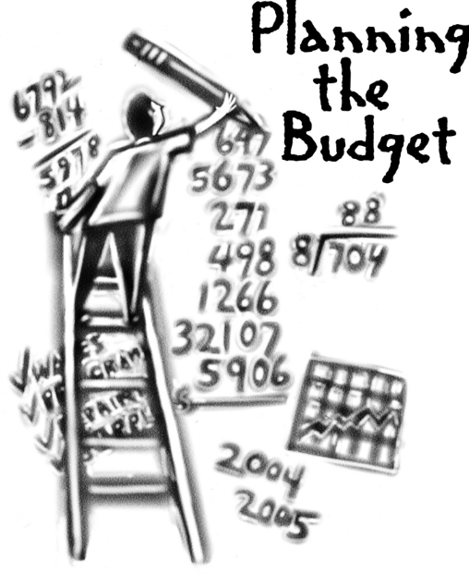
Overview of FY ‘25 GO Team Budget Process
Step 7 GO Team Final Budget Approval Meeting
Budgets Approved by March 15
Step 6 Principals: HR Staffing Conferences Begin
Late February – Early March
Step 5 GO Team Feedback Session
February – ongoing if necessary
Step 4 Principals: Associate Supt. Discussions and Review
February (supports needed, specific challenges, coaching)
Step 3 GO Team Initial Budget Session
January 17 – early February
Step 2 Principals: Workshop FY 25 Budget
January 17
Step 1 Review and Update Strategic Plan
GO Teams are encouraged to have ongoing conversations

Slide 5
Budget Feedback Meeting
What
The GO Team feedback session(s) should be scheduled for the principal to provide an overview of the school’s draft budget for the GO Team members and the general public.
Why
This meeting provides an opportunity for GO Teams to discuss how the school’s budget has been allocated to support the programmatic needs and key strategic priorities.
When
Meetings must be held in February before staffing conferences. May be combined with the allocation meeting (as needed), if the GO Team has completed strategic plan updates and ranked strategic priorities.
Notes:
Looking for general consensus prior to Staffing Conferences

Slide 6
FY25 Budget Parameters
FY25 School Priorities | Rationale
Intentionally focus on closing the subgroups achievement gaps | Even though we have improved a great deal in our subgroups the gap is still our area of greatness need.
Implement research-based teaching strategies supported by student data. | With the turnover rate of teachers and the need to hire alternatively certified teacher it has become increasingly important to offer continuous professional development on teaching strategies.
Create a system of supporting problem solving and action with students and staff through the lens of IB. | As an IB school it is necessary to continue our focus on growing our IB practices.
Notes:
Review the priorities that the GO Team has developed and the rationale for these priorities. Feel free to copy this slide if you have more than 3 priorities to account for.

Slide 7
FY25 Budget Parameters
FY25 School Priorities | Rationale
Create and implement a system that promotes equitable practices in all areas of the school community. | As we continue to disrupt the current system of inequalities it is necessary to set up a system where this questioning can happen as a part of the function of the school.
Implement a robust wrap around program with clear goals, communication plan, and measurement structure. | In a school community with such diversity wrap around services must be clearly accessible.
Notes:
Review the priorities that the GO Team has developed and the rationale for these priorities. Feel free to copy this slide if you have more than 3 priorities to account for.

Slide 8
Descriptions of Strategic Plan
Breakout Categories
Priorities: FY25 funding priorities from the school’s strategic plan, ranked by the order of importance.
APS Five Focus Area: What part of the APS Five is the priority aligned to?
Strategies: Lays out specific objectives for school’s improvement.
Request: “The Ask” What needs to be funded in order to support the strategy?
Amount: What is the cost associated with the Request?

Slide 9
FY25 Strategic Plan Break-out
Priorities | APS FIVE Focus Area | Strategies | Requests | Amount
Intentionally focus on closing the subgroups achievement gaps | Fostering Academic Excellence for All | Small group differentiated support Resources and supplies SWD Teachers and staff professional development | Reading Teacher EIP Teachers’ Media specialist MTSS specialist Teacher Tutors | $1,036,620 Reading TE/EIP 764,196 Media 123,029 MTSS 119,395 TT 30,000
Implement research-based teaching strategies supported by student data. | Fostering Academic Excellence for All | Support for teacher development of content and evidenced based instructional models | Reading Coach Math Coach Classroom teachers (24) Field Trips/Supplies | $2,131,985 Coach 261,080 TE 1,855,905 FT 15,000
Create a system of supporting problem solving and action with students and staff through the lens of IB. | Fostering Academic Excellence for All | Weekly/Monthly IB planning meeting. IB team for planning World Language/Fine/Arts programing | IB coach Professional Development for IB Gifted Coordinator Substitutes ART/Music/Band/PE teachers | $679,975 IB 130,540 IB PD 30,000 Sub 50,000 TE 469,435
Create and implement a system that promotes equitable practices in all areas of the school community. | Fostering Academic Excellence for All | Professional development in culturally responsive teaching. Support for Enrichment at WELA | (GRANT FUNDED) Substitutes WELA staff (2) | $132,000 $30,000 102,000
Implement a robust wrap around program with clear goals, communication plan, and measurement structure. | Fostering Academic Excellence for All | Increase parent engagement from all communities. Family Engagement activities | School Based Business Manager Climate and Culture AP Restorative Practices Coach Counselor | $544,155 SBBM 140,638 AA AP 140,638 RPC 130,540 C 132,339
Notes:
For the next few slides, I will show you how I have allocated the budget to support our strategic priorities.
Based on our strategic priorities and funds we received, here is a break-out of the priorities, which focus area it addresses, the strategies that will be implemented, the purchase request, which funding source was used and the amount.

Slide 10
Plan for FY25 Title I Family Engagement Funds
$6,800
Priorities | APS FIVE Focus Area | Strategies | Requests | Amount
Create and implement a system that promotes equitable practices in all areas of the school community. | Fostering Academic Excellence for All | Pre-k and K student kits for at home practice Monthly Engagement activities with the lens of IB and academics | Kits Supplies for activities | Kits $10,000
Notes:
For the next few slides, I will show you how I have allocated the budget to support our strategic priorities.
Based on our strategic priorities and funds we received, here is a break-out of the priorities, which focus area it addresses, the strategies that will be implemented, the purchase request, which funding source was used and the amount.

Slide 11
FY25 Budget by Function (Required)
*Based on Current Allocation of School Budget
School | Toomer Elementary School
Location | 5567
Level | ES
Principal | Caroline Brown
Projected Enrollment | 439
Account | Account Description | FTE | Budget
1000 | Instruction | 49.10 | $5,122,413
2100 | Pupil Services | 4.50 | $510,264
2210 | Improvement of Instructional Services | 4.00 | $510,664
2213 | Instructional Staff Training | - | $-
2220 | Educational Media Services | 2.00 | $173,198
2400 | School Administration | 7.00 | $828,156
2600 | Maintenance & Operations | 4.00 | $246,789
2700 | Transportation | - | $5,000
Total |  | 70.60 | $7,396,485
Notes:
I am passing out the definitions for these funding categories. You will see what makes up each category. Although the school’s total budget amount will not change, allocation per function may change depending on our conversations and school needs.

Slide 12
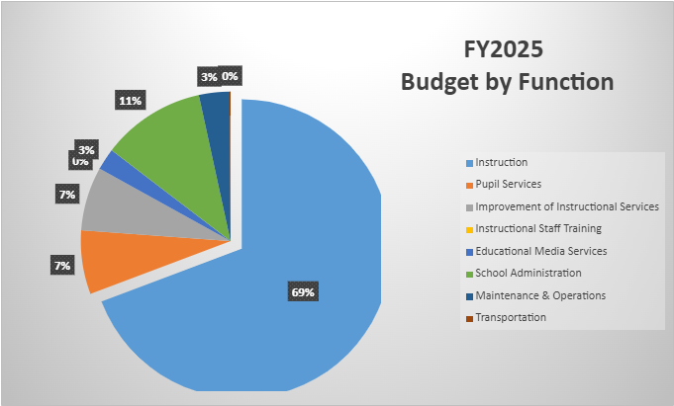
FY25 Budget by Function (Required)
*Based on Current Allocation of School Budget
Notes:
Explain the pie chart and allocations

Slide 13
DISCUSSION OF RESERVE AND HOLDBACK FUNDS

Slide 14
Plan for FY25 Leveling Reserve
$93,674
Priorities | APS FIVE Focus Area | Strategies | Requests | Amount
Intentionally focus on closing the subgroups achievement gaps | Fostering Academic Excellence for All | Increase Media choices Digital Textbooks | Media textbooks Lexia | $10,000 12,000
Create a system of supporting problem solving and action with students and staff through the lens of IB. | Fostering Academic Excellence for All | Professional Development for staff for production studio | PD/consultant | $10,000
Implement research-based teaching strategies supported by student data. | Fostering Academic Excellence for All | Professional Development for staff Professional Development Text Provide teachers with appropriate materials for research-based instruction | IRA Conference PD Text Supplies/Class text | $15,000 $5,000 $30,000
Notes:
For the next few slides, I will show you how I have allocated the budget to support our strategic priorities.
Based on our strategic priorities and funds we received, here is a break-out of the priorities, which focus area it addresses, the strategies that will be implemented, the purchase request, which funding source was used and the amount.

Slide 15
Plan for FY25 Title I Holdback
$14,960
Priorities | APS FIVE Focus Area | Strategies | Requests | Amount
Create and implement a system that promotes equitable practices in all areas of the school community. | Fostering Academic Excellence for All | Monthly Engagement activities with the lens of IB and academics | Supplies and materials for monthly engagement | 14,960
Notes:
For the next few slides, I will show you how I have allocated the budget to support our strategic priorities.
Based on our strategic priorities and funds we received, here is a break-out of the priorities, which focus area it addresses, the strategies that will be implemented, the purchase request, which funding source was used and the amount.

Slide 16
SUMMARY OF POSITION CHANGES TO SUPPORT THE STRATEGIC PLAN
CREATED | REMOVED
None | None

Slide 17
QUESTIONS FOR THE GO TEAM TO CONSIDER AND DISCUSS
Are our school’s priorities (from your strategic plan) reflected in this budget?
Are new positions and/or resources included in the budget to address our major priorities?
Do we know (as a team) the plan to support implementation of these priorities beyond the budget (ex. What strategies will be implemented)?
What tradeoffs are being made in order to support these priorities?
How are district and cluster priorities reflected in our budget?
Cluster priorities- what staff, materials, etc. are dedicated to supporting our cluster’s priorities?
Signature programs- what staff, materials, etc. are dedicated to supporting our signature program?
Are there positions our school will share with another school, i.e. nurse, counselor?
Notes:
CHAIR - Our final task for today! Here are questions that we need to consider to ensure we have a good working draft budget. Let’s walk through them together.

Slide 18
Where We’re Going?
Our next meeting is the Budget Approval Meeting
What:
During this meeting we will review the budget, which should be updated based on feedback from the staffing conference, Associate Superintendents, and key leaders. After review, GO Teams will need to take action (i.e., vote) on the FY25 Budget.
Why:
Principals will present the final budget recommendations for GO Team approval.
When:
All approval meetings must be held after staffing conferences. Budgets must be approved by March 15th.

Slide 19
What’s Next?
February
HR Staffing Conferences (Late February)
March
Final GO Team Approval Meeting (AFTER your school’s Staffing Conference and BEFORE Friday, March 15th)
Notes:
In February, we will meet again to discuss how the school’s budget has been allocated to support the programmatic needs and FY23 key strategic priorities.
If think we need to continue our budget conversations, we will schedule additional meetings. My goal is to make sure your voices are reflected in our school’s budget.
I will also be meeting with my Associate Superintendent, program managers and other key leaders to go over our budget and to make sure the school is meeting the standards of service and appropriately staffing.
During the week of Feb. 24th -March 2nd , HR Staffing Conferences will be held. At this meeting, I will present my plan for staff utilization, resource distribution and plan for staffing implications.
We will need to approve the budget at the ________ meeting.

Slide 20
Thank you

